Slide 1
Week 1-2
Topic: Introduction to Research
Dr. Waqar Mehmood
Professor
RSCI
RIU

Slide 2
TOC
What is Research
Significance of Research
How Research should be conducted
Research Model
Research Methods vs Methodology
Types of Research
….

Slide 3
Meaning of Research
The Advanced Learner’s Dictionary of Current English lays down the meaning of research as [1]
“a careful investigation or inquiry specially through search for new facts in any branch of knowledge.”¹
Redman and Mory define research as a [1]
“systematized effort to gain new knowledge.”²
¹ The Advanced Learner’s Dictionary of Current English, Oxford, 1952, p. 1069.
² L.V. Redman and A.V.H. Mory, The Romance of Research, 1923, p.10.

Slide 4
Meaning of Research [1]
According to Clifford Woody research comprises
defining and redefining problems,
formulating hypothesis or suggested solutions;
collecting, organising and evaluating data;
making deductions and reaching conclusions; and
at last carefully testing the conclusions to determine whether they fit the formulating hypothesis. [1]

Slide 5
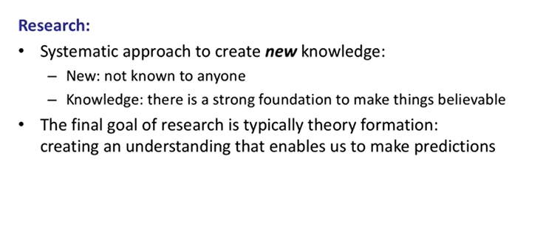
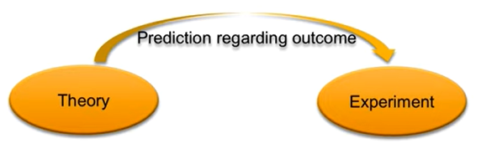
Research [2]

Slide 6
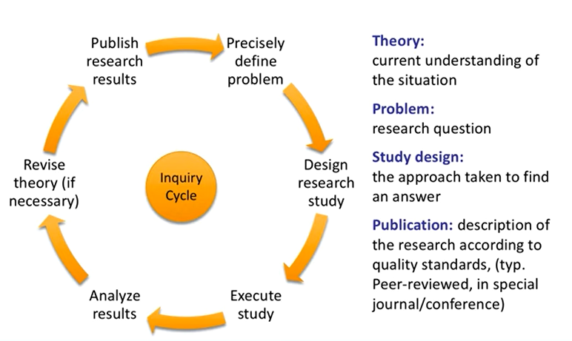
Research cycle [2]

Slide 7
Research key features:
Systematic & organized
Objective & logical
Empirical & verifiable
Reproducible

Slide 8
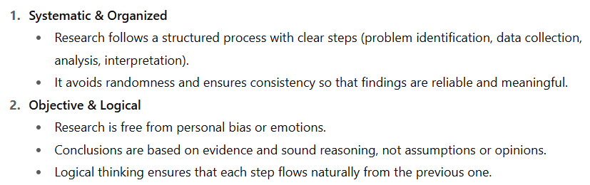
Research key features:

Slide 9
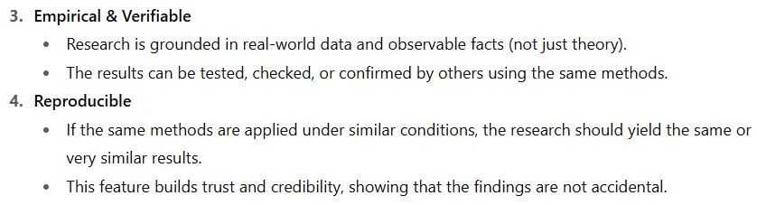
Research key features:

Slide 10
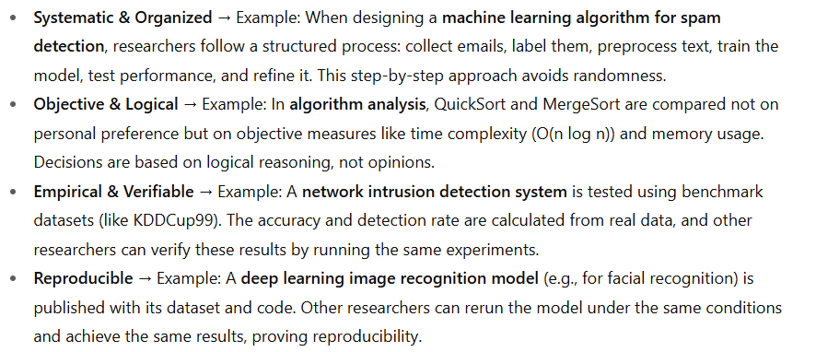
Research key features [3]

Slide 11
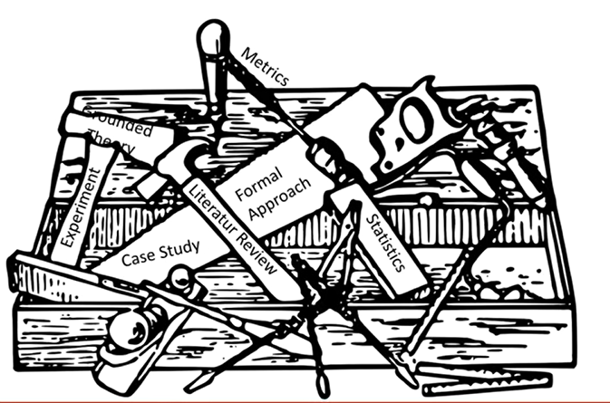
Research Toolbox

Slide 12
Significance of Research
All progress is born of inquiry.
Doubt is often better than overconfidence, for it leads to inquiry, and inquiry leads to invention” Hudson Maxim
Research teaches scientific and inductive thinking, and it promotes the development of logical habits of thinking and organization.
Research provides the basis for nearly all government policies in our economic system.

Slide 13
Importance of Research
Research expands your knowledge base
Research gives you the latest information
Research builds your credibility
Research helps you narrow your scope
Research teaches you better judgement
Research introduces you to new ideas
Research helps with problem-solving
Research helps you reach people
Research encourages curiosity
Notes:
Discernment=faham

Slide 14
How it should be conducted??
Systematically
Using sound research methods
Using appropriate research tools and simulators
Avoiding plagiarism
Honestly
Avoiding bias
Avoiding conflict of interest
Avoiding falsifying results

Slide 15
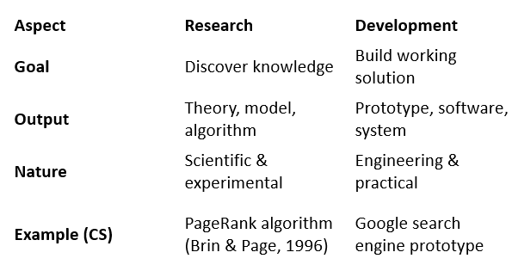
Research vs. Development
Research → Discovering new knowledge
Development → Applying knowledge to build solutions

Slide 16
Research Model
Real World
Experiment
Results
Theory
Knowledge

Slide 17
Why Undertake Research?
To investigate some existing situation or problem.
To provide solutions to a problem.
To explore and analyze more general issues.
To construct or create a new procedure or system.
To explain a new phenomenon.
To generate new knowledge.
A combination of two or more of any of the above.

Slide 18
References
C.R. Kothari, Research Methodology: Methods and Techniques.
Research Methods Lecture: Chapter 1 – Introduction, Software Systems Engineering Group, Prof. Dr. Klaus Schmid
https://chatgpt.com/c/68e21d6a-baa4-8321-96cd-0b1075915337

